Slide 1
Welcome to Presdales Duke of Edinburgh Parent information Evening 10th January 2017

Slide 2
What is DofE ?
It is a non-competitive programme for 14 to 24 years olds.
You achieve an Award by setting and achieving personal goals in the following sections:
Volunteering
Physical
Skills
Expedition
Participants must get involved in their activity for a minimum of 1 hour each week for the duration of the timescale (e.g. 3 months, 6 months). If a week is missed, through holiday or illness for example, the timescale must be extended.

Slide 3
Bronze Award (14+ years)
Volunteering | Physical | Skills | Expedition
3 months | 3 months | 3 months | Plan, train for and complete a 2 day, 1 night expedition
All participants must undertake a further 3 months of Volunteering, Physical or Skills.
Cost
Enrolment Fee £27 paid by ? if accepted
Expedition fee (including equipment) £103 paid by ?

Slide 4
Choosing activities
You must read and use the helpful lists and category finder on:
http://www.dofe.org/en/content/cms/doing-your-dofe/activities-sections
Activities are in specific sections, please check that your chosen activity fits. For example,
Dance is NOT a skill but a physical recreation.
Make sure you have a willing and appropriately trained or experienced assessor, not a close relative.

Slide 5
Suggestions and reminders :
Choose activities you enjoy.
It could be something that you are already doing or that you’ve always wanted to try.
The same activity cannot be credited in all three sections,
E.g. Football coaching (volunteering), recreational football playing in a team (physical recreation) and learning to be a football referee (skill) is not allowed. Only two sections can be related.

Slide 6
Attendance Record
We ask that part of your evidence is a copy of an attendance record for your volunteering, skills and physical sections.
Remember to record your start and finish dates for each of your sessions.
Date | Signature | What you did?

Slide 7
Assessors:
A suitably qualified adult who is not a close relative.
They must supervise your activity, not
necessarily for every hour, but you might need to
keep a photo or written diary.
At the end they must complete a report showing your commitment, skills and progression.
This is easiest online (with your unique ID number),
at http://www.dofe.org/assessors.

Slide 8
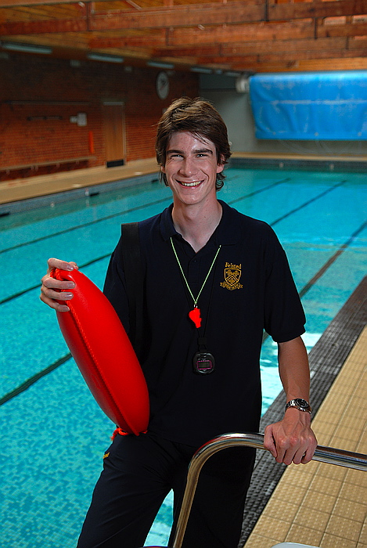
Volunteering
To inspire young people to make a difference in their communities or to an individual’s life
To develop compassion by giving service to others, but in a location of safety for themselves.
Volunteering is simple. It’s giving time to non profit making organisations, without getting paid.
At least 3/4 of the activity needs to be practical, only a 1/4 can be training.
The young people cannot help a commercial company, e.g. a soccer club or dance school, nor work in the private home of a neighbour or friend.

Slide 9
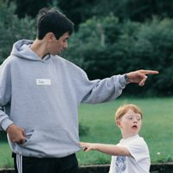
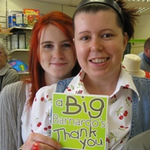
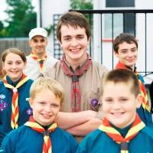
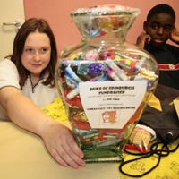
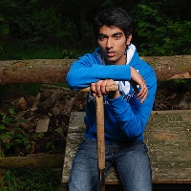
Volunteering categories
Helping people
Community action and raising awareness
Coaching, teaching and leadership
Working with the environment or animals
Helping a charity or community organisation
Notes:
Explain why we have chosen these activities – flexible enough that all volunteering activities should fit in. Old categories were very prescriptive. Make it clear that some activities will fit into more than one category, this doesn’t matter and will often depend on the aim of the young person.
This is outlined on pages 41 – 42 on the DofE Handbook.
Give example on page 42 of Handbook about how First Aid training could be 3 months as a Bronze Skill for one person or training for 3 months and 9 months practical volunteering with St John Ambulance as a Gold Volunteering activity for another.
You could use any example here:
A Bronze DofE group attends a police course once a week to learn about the criminal justice system. As part of the course, the group are asked to design a project to raise awareness about personal safety in their community. A Gold DofE programme participant supervises the group and the police officer is the Assessor. The group deliver a number of assemblies to their peers as well as at the local primary school on how to stay safe.

Slide 10
Volunteering Section
What activity do you think that you might do for your Volunteering ?
Category: Activity:
What do you want to achieve?
Location:
I could be assessed by Phone number:
Assessor’s
Position/Qualification: Email:

Slide 11
Volunteering Section
What activity do you think that you might do for your Volunteering ?
Category: Helping people Activity: Helping at Brownies
What do you want to achieve? Helping younger children have fun and embrace the spirit of the organisation
Location: 1st Ware Brownies, Pinewood School, Ware SGXX 9XX
I could be assessed by Mrs C Leader Phone number: 01992 567890
Assessor’s
Position/Qualification: Brownies Leader Email: abrownieleader@barnowl.com
ALL information must be filled in.

Slide 12
Physical – Aim
To inspire young people to greater physical fitness
To encourage a healthy lifestyle through participation and progression in physical activity
In short, anything that requires a sustained level of physical energy when doing an activity.
You are free to do this section independently or as part of a team.

Slide 13
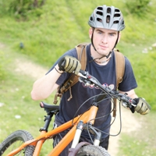
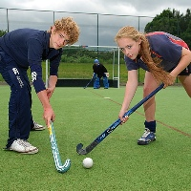
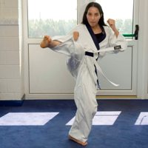
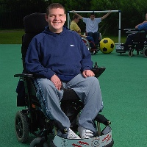
Physical categories
Team sports
Individual sports
Water sports
Racquet sports
Dance
Fitness
Extreme sports
Martial arts

Slide 14
Physical Section
What activity do you think that you might do for your Physical?
Category: Activity:
What do you want to achieve?
Location :
I could be assessed by Phone number:
Assessor’s
Position/Qualification: Email:

Slide 15
Physical Section
What activity do you think that you might do for your Physical?
Category: Fitness Activity: Running
What do you want to achieve? Faster Times
Location : Ware Running Club, Presdales School, Ware SGX 9XX
I could be assessed by Ms A Running Coach Phone number: 01992 567890
Assessor’s
Position/Qualification: Running Coach Email: acoach@running.com
ALL information must be filled in.

Slide 16
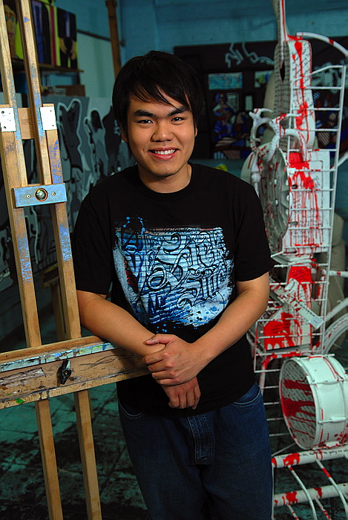
Skills – Aim
To inspire young people to develop practical and social skills and personal interests.
You must be able to prove that you have broadened your understanding and increased your expertise in the chosen skill.
The key word is progression.
Activities can be undertaken on either an individual or group basis.

Slide 17
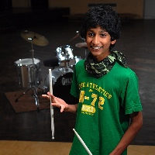
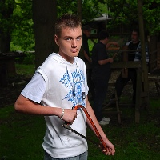
Skill categories
Creative arts
Performance arts
Science and technology
Care of animals
Music
Life skills
Learning and collecting
Media and communication
Natural world
Games and sports

Slide 18
Skill Section
What activity do you think that you might do for your Physical?
Category: Activity:
What do you want to achieve?
Location :
I could be assessed by Phone number:
Assessor’s
Position/Qualification: Email:

Slide 19
Skill Section
What activity do you think that you might do for your Skill?
Category: Music Activity: Singing
What do you want to achieve? I want to improve my singing and achieve Grade 6
Location: Singing Teachers House Ware SGXX 9XX
I could be assessed by Mr A Singing Teacher Phone number: 01992 567890
Assessor’s
Position/Qualification: Singing Teacher Email: asinging@teacher.com
ALL information must be filled in.

Slide 20
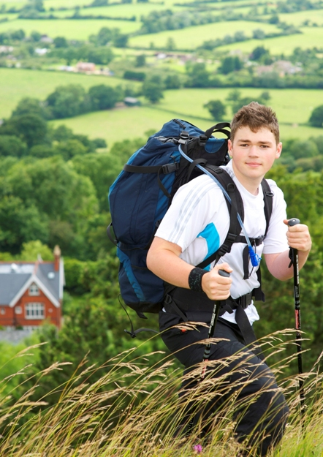
Expedition - Aim
To inspire young people to develop initiative, responsibility and a sense of adventure
to plan, train for
and complete an
adventurous journey as part of a team.

Slide 21
Remote supervision

Slide 22
Benefits
Learn to enjoy and respect the outdoors
Become more self reliant; able to overcome challenges.
Learn to manage risk.
Learn the importance of good organisation and attention to detail.
Recognise the needs and strengths of others and reflect on their own performance
Be able to take and share responsibility.
Improve decision-making skills and the ability to accept consequences.
Learn through experience.

Slide 23
The Expedition process
Preparation
Lunch time sessions
Training and
Practice expedition
Qualifying expedition
Project

Slide 24
Bronze Expedition Dates
Practice: Saturday 6th & Sunday 7th May
Assessment: Saturday 1st & Sunday 2nd July
You must attend both Training Days and camp overnight to qualify for the Assessed expedition.
You must Complete both days and camp overnight as a team to pass your assessed expedition.
As this is a national award we are unable to make any exceptions.

Slide 25
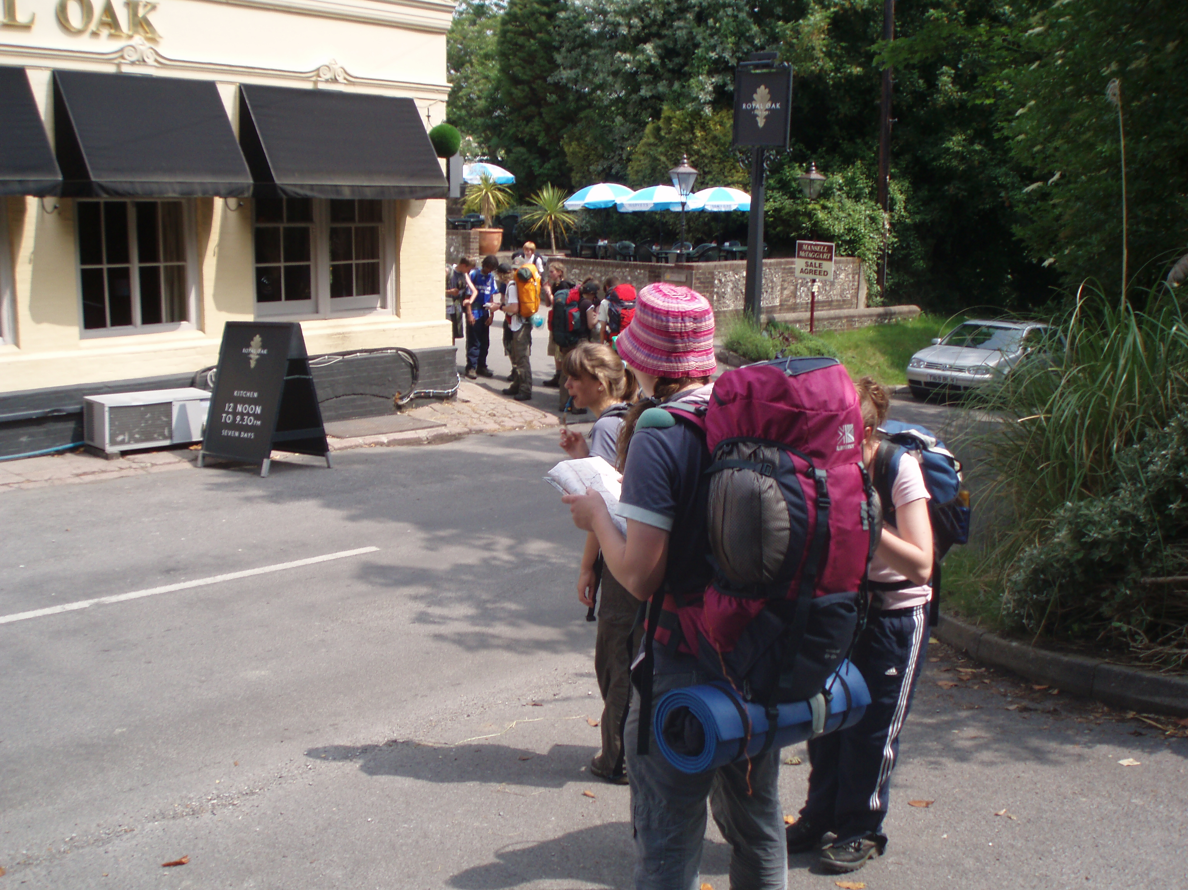
Expedition Training
Already completed some preparation during lunchtime sessions.
Make sure you have walking boots that fit and that you get out and walk in them prior to the training weekend.
You will need to make sure you are fit enough to walk for 6 hours carrying your equipment.
Navigation and team work.
Camping.
Respecting the countryside.

Slide 26
Expedition Training
Map and compass work
Route planning
First Aid and emergency awareness
Safety and the weather
Campcraft and country code
Safe use of Trangia stoves
Menu planning and food
Kit lists
Packing rucksacks

Slide 27
Team Preference
Once accepted we will talk to selected students about Team preferences.
Teams can have a maximum of 7 people.
We ask you to arrange yourselves into groups of 3 or 4 if possible. Larger groups will NOT be accepted.
We will then put two groups together to get teams of 7.
The DofE expedition is about working as a team, learning about yourself and meeting new people.
We will try to ensure that you will be with at least one of your choices, however we cannot make any guarantees.

Slide 28
The Application Process
Get an application form, either from the office or from Presdales website.
Decide what activates you want to do for each section.
Find someone, suitably trained or qualified, who is not a family member, who could assess your activity for each section.
Fill in the question section to show you have understood the fundamental principles of D of E.
Put your fully completed application form to Lorraine Eyre in the school office by the deadline, ?.

Slide 29
Finally
We are able to accommodate a maximum of 35 participants.
Only complete application forms will be accepted.
If more than 35 applications which fulfil all of the requirements, are received by the closing date, places on the scheme will be allocated using a random selection process and reserve lists formulated in case participants decide not to accept their place.

Slide 30
Is D of E for Me?
If you :
Have an interest in the outdoors
Are a reliable team member who does their share and gets on well with others
Enjoy keeping fit
Like to learn new things
Make sure you complete things, even if you are not enjoying them
Are able to manage my time
You like helping people
Then the answer is YES!

Slide 31
Key Dates – Bronze
Date | Activity

